Slide 1
PHP Practice 1

Slide 2
Big Picture
Add News!
Edit News!
Delete News!
Read all the news!
read2.php
add_news.php
news.php
news2.php
Read one news!
save_news.php
edit_news.php
del_news.php
save_edit_news.php
read.php
Almost all the programs will use conn.php to connect to the database!

Slide 3
How about adding a news topic in the website?

Slide 4
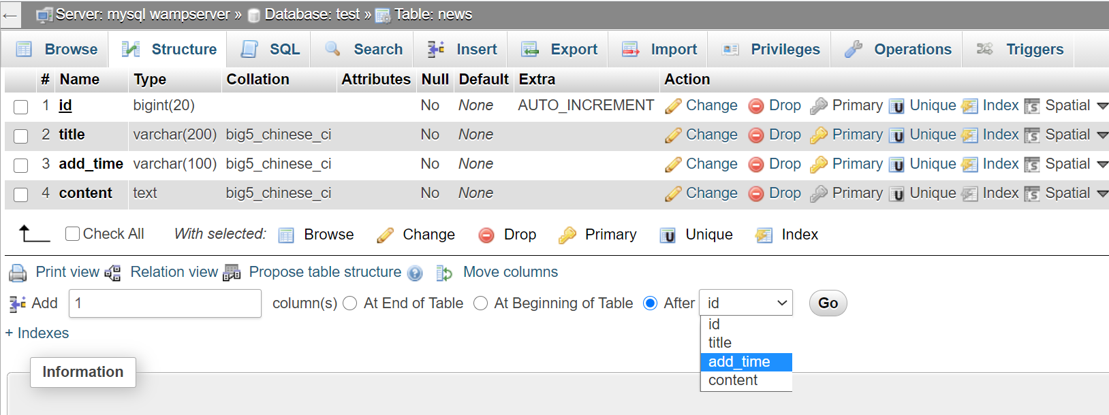
Add more attributes

Slide 5
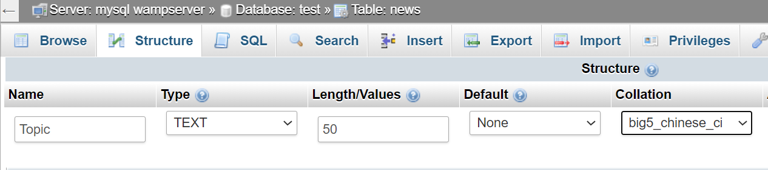
Add more attributes

Slide 6
How to modify the program?

Slide 7
Modify add_news.php
Example!
…
<tr>
<td width="30%" align="right">News Title</td>
<td width="70%" align="left"><input type="text" name="title" size="30"/></td>
</tr>
<tr>
<td width="30%" align="right">News Topic</td>
<td width="70%" align="left"><input type="text" name="topic" size=“30"/></td>
</tr>
<tr>
<td align="right">New Content</td>
<td align="left"><textarea name="content" cols="30" rows="5"></textarea></td>
</tr>
….

Slide 8
Try to do the remaining parts by yourself!

Slide 9
Add_news.php
<!DOCTYPE html PUBLIC "-//W3C//DTD XHTML 1.0 Transitional//EN" "http://www.w3.org/TR/xhtml1/DTD/xhtml1-transitional.dtd">
<html xmlns="http://www.w3.org/1999/xhtml"> <head>
<meta http-equiv="Content-Type" content="text/html; charset=gb2312" />
<title>input news</title>
<style>
form{
padding:0px;
margin:0px;
}
</style>
</head>
<body>
<table width="70%" height="30" border="0" align="center" cellpadding="0" cellspacing="0">
<tr>
<td align="center">Fill in the information</td>
</tr>
</table>
<form action="save_news.php" method="post">
<table width="70%" border="0" align="center" cellpadding="0" cellspacing="0">
<tr>
<td width="30%" align="right">News Title</td>
<td width="70%" align="left"><input type="text" name="title" size="30"/></td>
</tr>
<tr>
<td align="right">New Content</td>
<td align="left"><textarea name="content" cols="30" rows="5"></textarea></td>
</tr>
</table>
<table width="70%" height="30" border="0" align="center" cellpadding="0" cellspacing="0">
<tr>
<td align="center"><input type="submit" name="submit1" value="Confirm to add"/></td>
</tr>
</table>
</form>
</body>
</html>

Slide 10
Save_news.php
<?php
$hostname = "localhost"; //local hist
$database = "test"; //database name
$username = ""; //user
$password = ""; //password
$con = mysqli_connect($hostname, $username, $password, $database);
if (mysqli_connect_errno())
{
echo "Failed to connect to MySQL: " . mysqli_connect_error();
exit();
}
?>
<?php
$title=$_POST["title"];
$content=$_POST["content"];
if(function_exists('date_default_timezone_set'))
{
date_default_timezone_set('Hongkong');
}
$add_time=date("Y-m-d");
$sql = "INSERT INTO news (title,content,add_time) VALUES ('$title','$content','$add_time')";
echo $sql;
$result = @mysqli_query($con,$sql);
if($result)
{
echo "Add successfully,<a href='add_news.php'>return to continue</a>";
}
else
{
echo "Fail to add,<a href='add_news.php'>please return</a>";
}
?>

